Slide 1
Fisheries participation networks Update May 2021

Slide 2
PFMC meeting comments March 2021: SSC
The interpretation of the fisheries participation networks can be confusing (Figure 6.4.1). The size of nodes in the figure are described as being proportional to revenue from a given fishery. However, node size does not relate to overall revenues at those ports for those species. Node size reflects the median percent of individuals’ total revenue accounted for by that species for participants in that fishery and port group. Thus, if most participants get most of their revenue from that fishery, the node size can be large even if the absolute revenue for individual participants and in total is small.

Slide 3
SSC-ES comments January 2021
Expanding stock availability metrics to more species and including participation networks may create opportunities to better track impacts to west coast fisheries from large-scale perturbations (which could include a pandemic).
The analysis is a good visualization of participation in fisheries and inter-regional differences in the combinations of fisheries available and complement the diversification indices in the report which use the same fishery definitions.
It is not clear that the network metrics presented are good indicators of concepts like community vulnerability or resilience. More validation of how these concepts relate to these metrics is needed before the results can be discussed in these terms.
The CCIEA report, if this work is to be included, could present results for each individual port. If this is not feasible, pick ports where large changes in the network metrics were observed over some time period.
The results should be shown over time to get a sense of how fishing patterns have changed and to get some context about the observed range of results
[echoed by John U on Council floor]

Slide 4
PFMC meeting comments March 2021: EWG
The EWG appreciates the use of fisheries participation networks and hopes that they can be used more broadly within the Council process. We have included similar information in updated Chapter 3 of the Fishery Ecosystem Plan, submitted as EWG Report 1 under Agenda Item I.3. and note that these networks may be useful to agencies exploring the effects of non-fishing activities on fisheries participants (e.g., C.2, Marine Planning Update). Council decision-making is usually separated by fishery management plan, which sometimes makes it difficult for the Council to see the potential effects of their decisions across fisheries.
[Link to FEP; Frank L on Council floor]
In addition to this annual report, the Council might also be interested in a retrospective analysis of the changes that have occurred in participation networks over time.
[echoed by John U on Council floor]
The EWG appreciates the inclusion of Theil Index to estimate revenue concentration across different fisheries and the introduction of fishery participation networks. These approaches look promising and we look forward to seeing if they can be useful in Council decisionmaking, particularly where the Council is considering decisions that may affect geographic distribution of harvest opportunities.

Slide 5
Updated analysis
Compare port-level networks to vessel-level networks
Port-level networks: nodes include if they contributed >=10% of revenue to the port in 2020

Slide 6
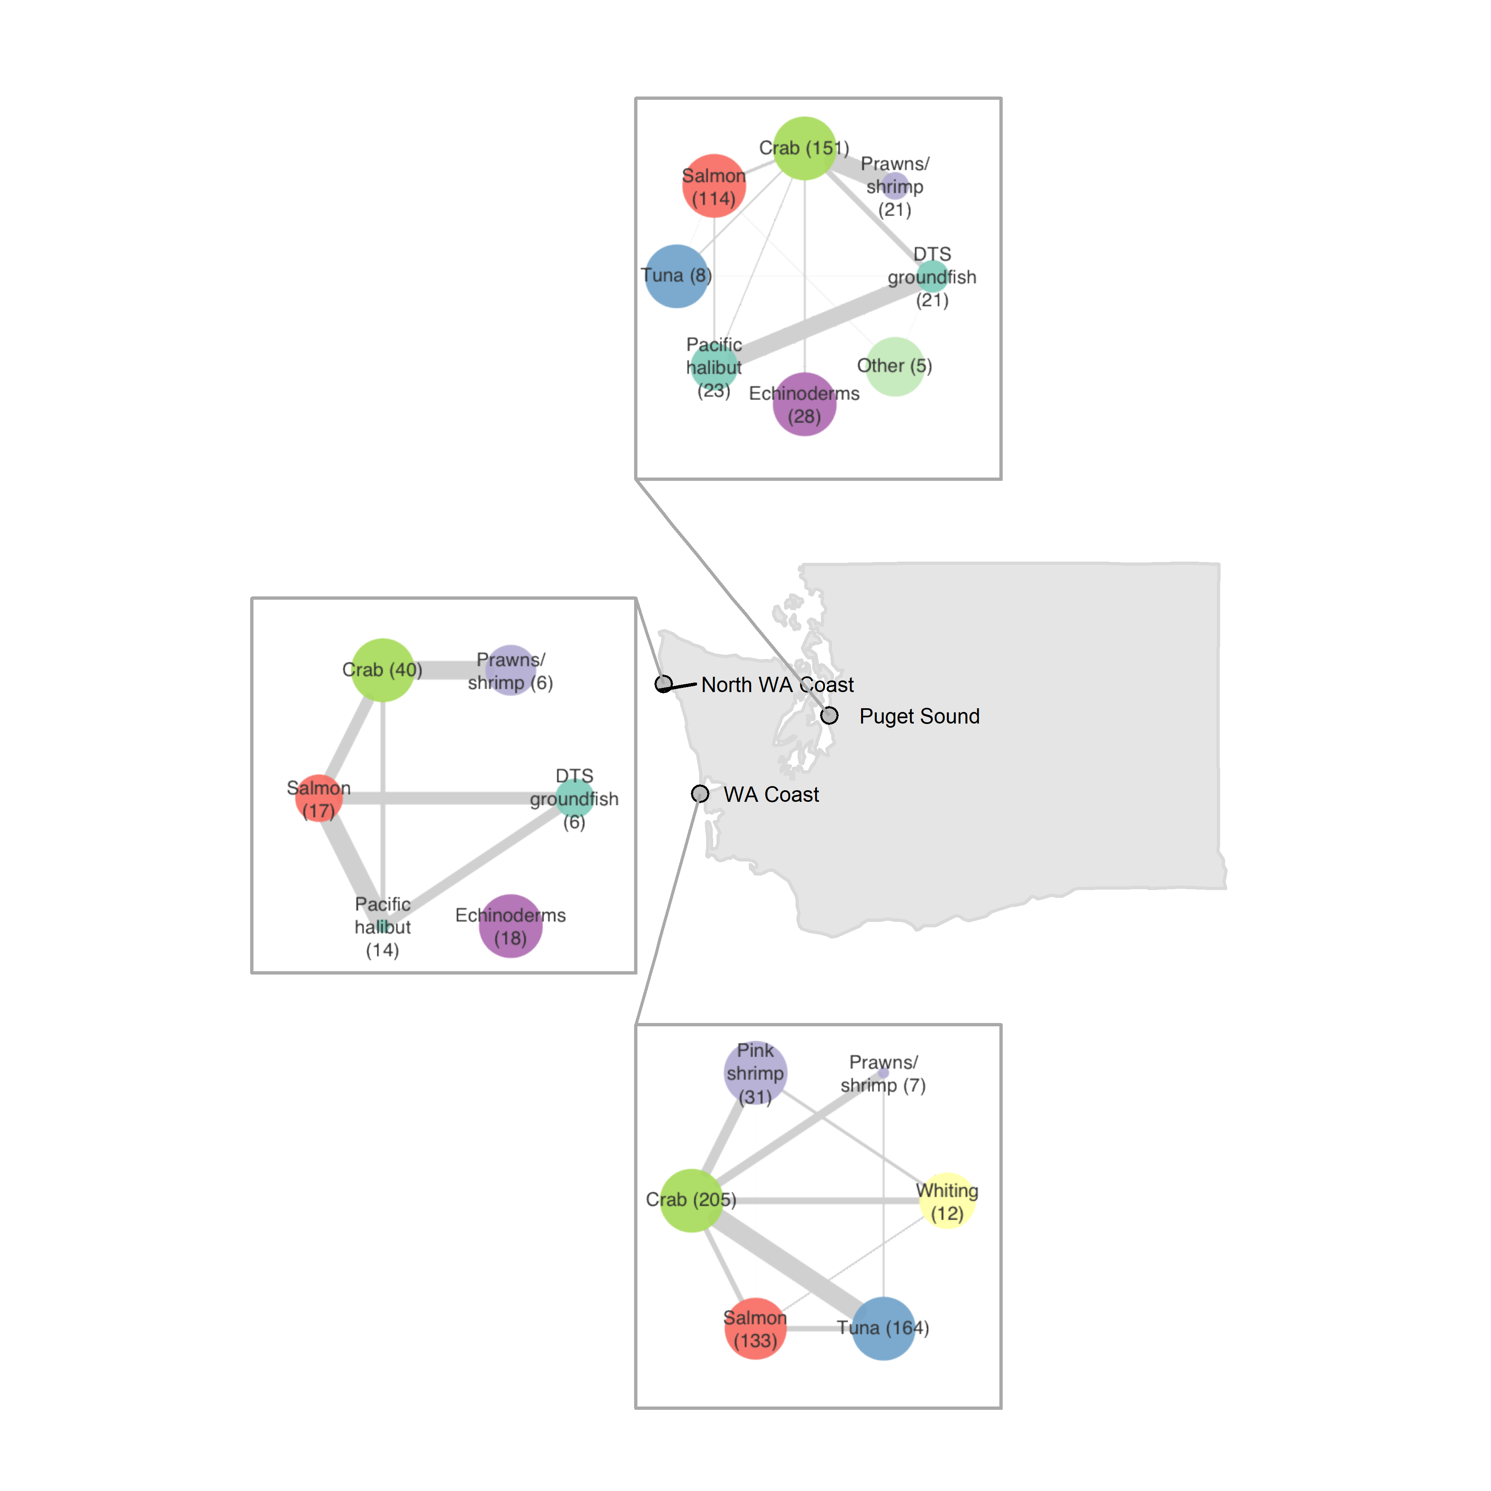
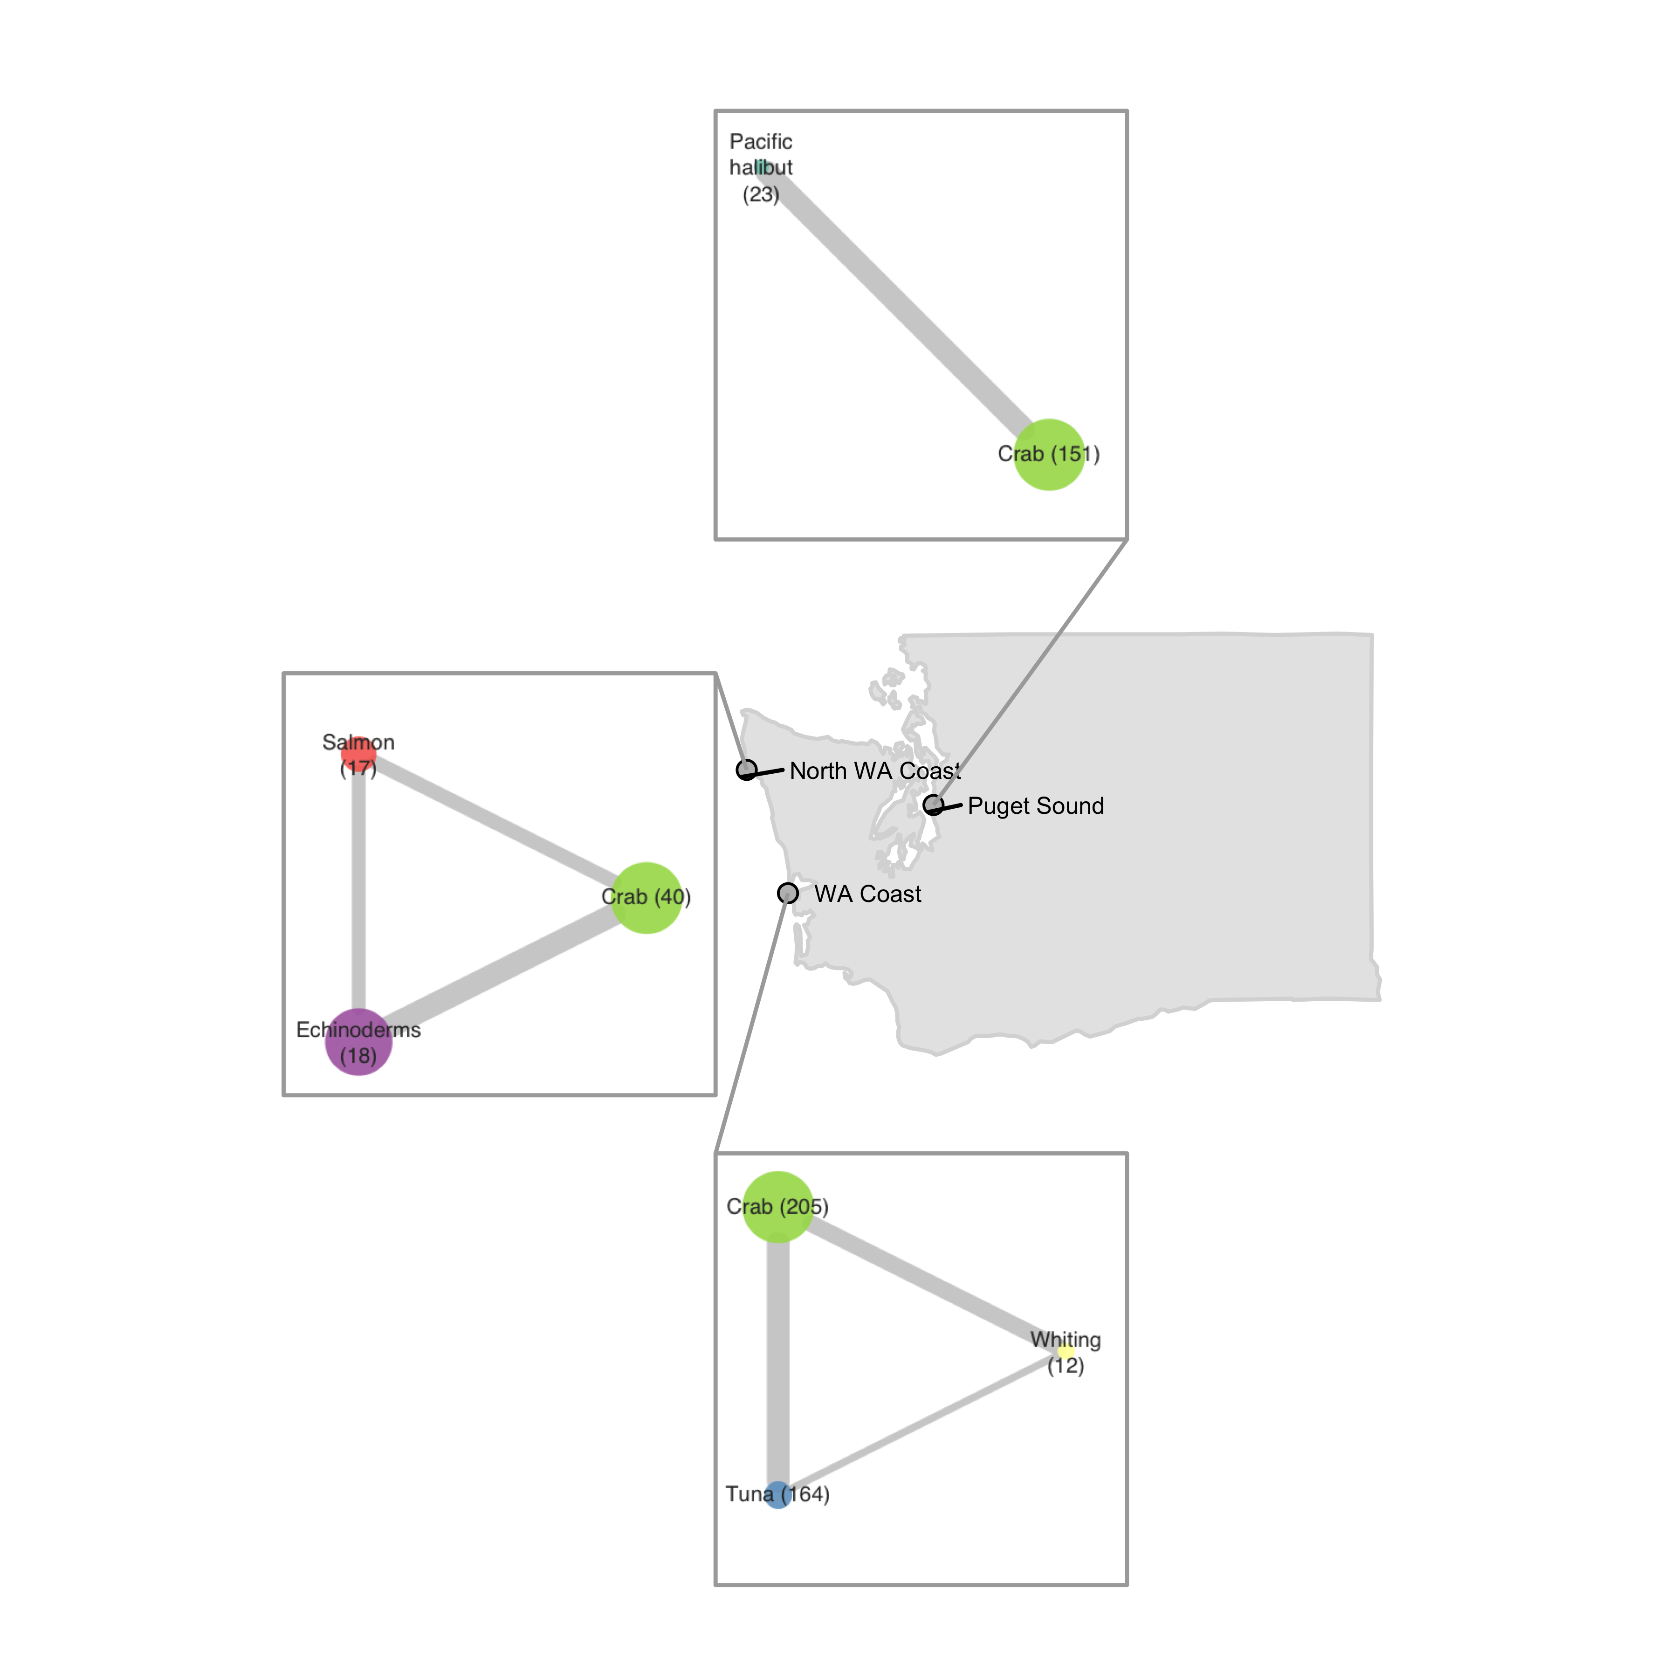
Vessel-level
includes fisheries that represent a median of 10% of vessel revenue in each port
Port-level
includes fisheries that represent at least 10% of total revenue in each port

Slide 7
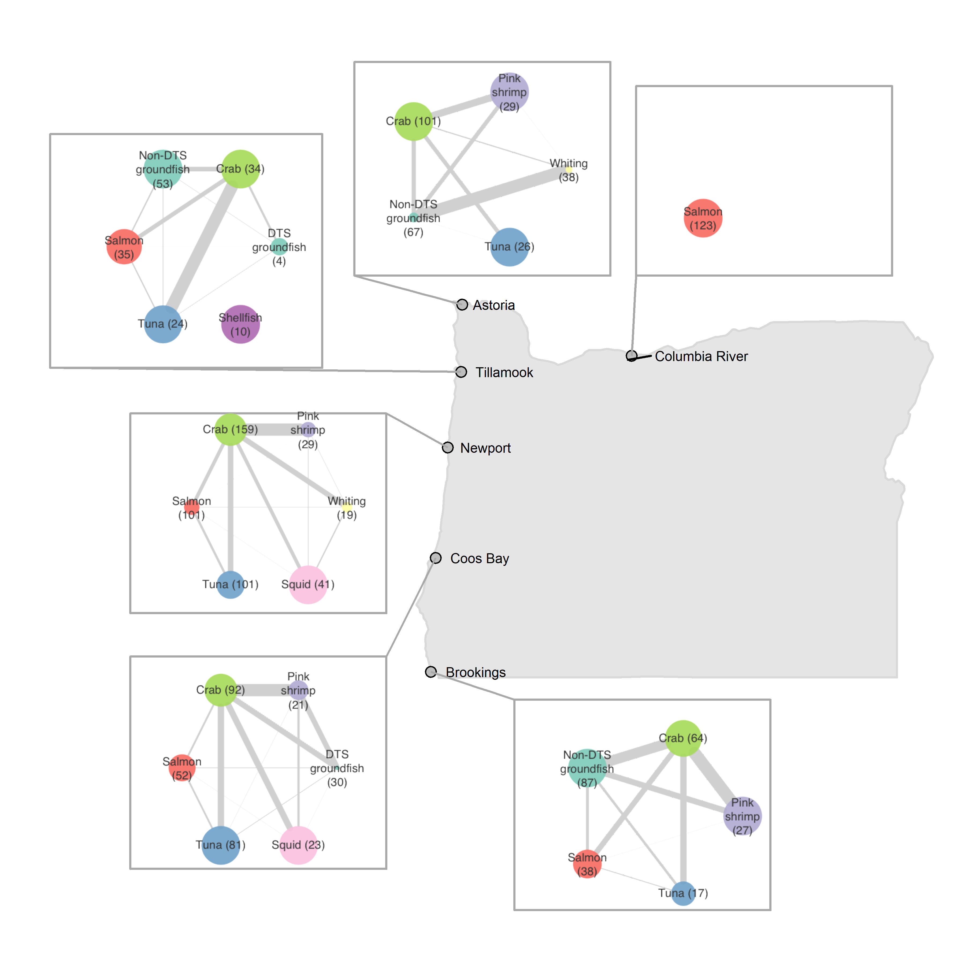
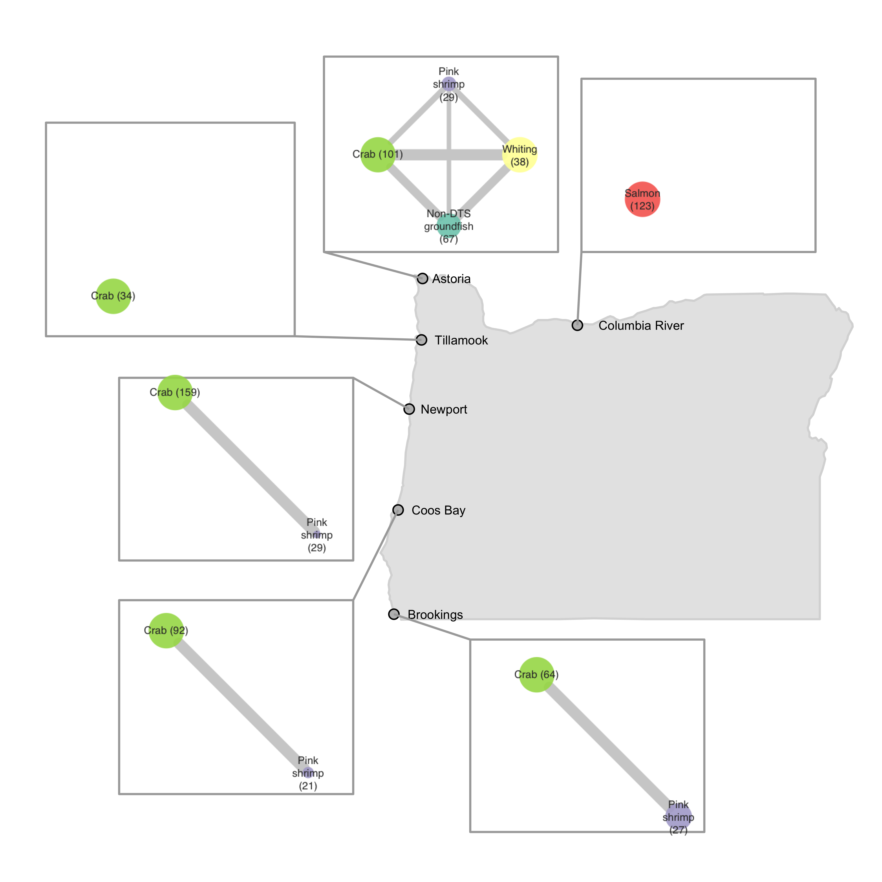
Vessel-level
includes fisheries that represent a median of 10% of vessel revenue in each port
Port-level
includes fisheries that represent at least 10% of total revenue in each port

Slide 8
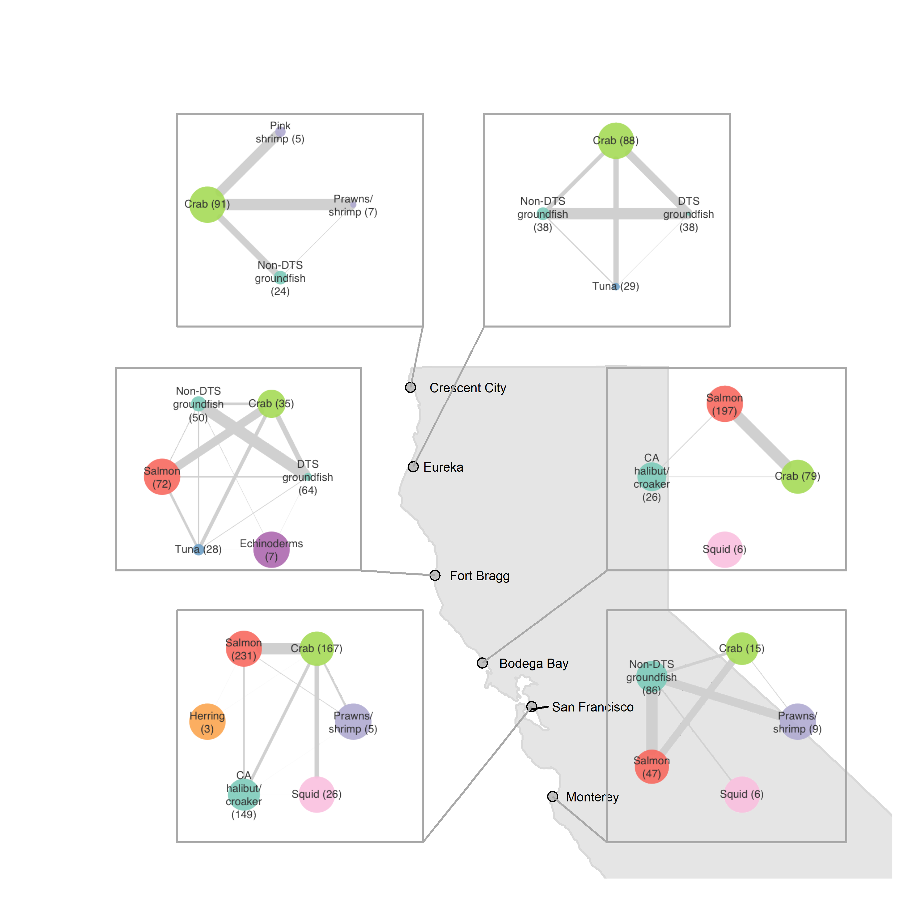
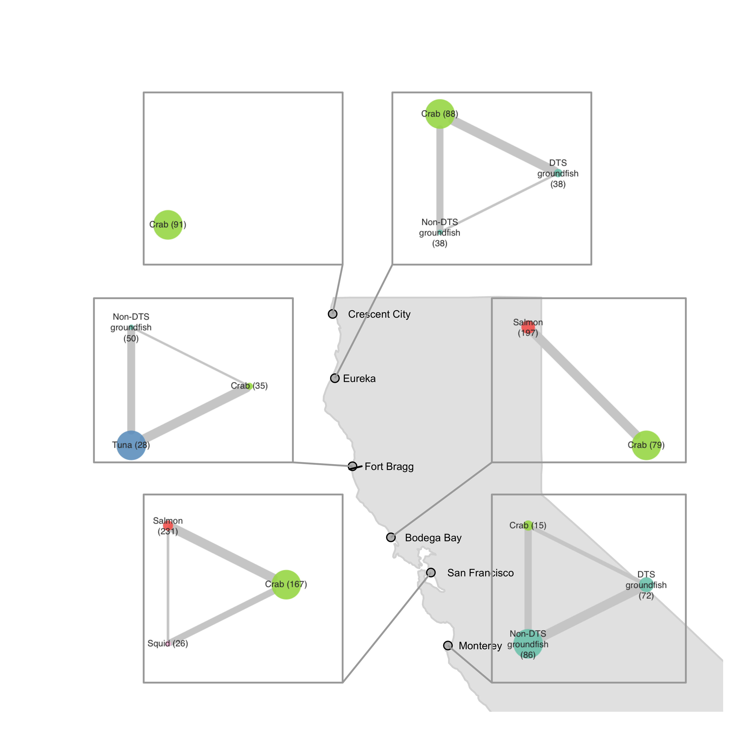
Vessel-level
includes fisheries that represent a median of 10% of vessel revenue in each port
Port-level
includes fisheries that represent at least 10% of total revenue in each port

Slide 9
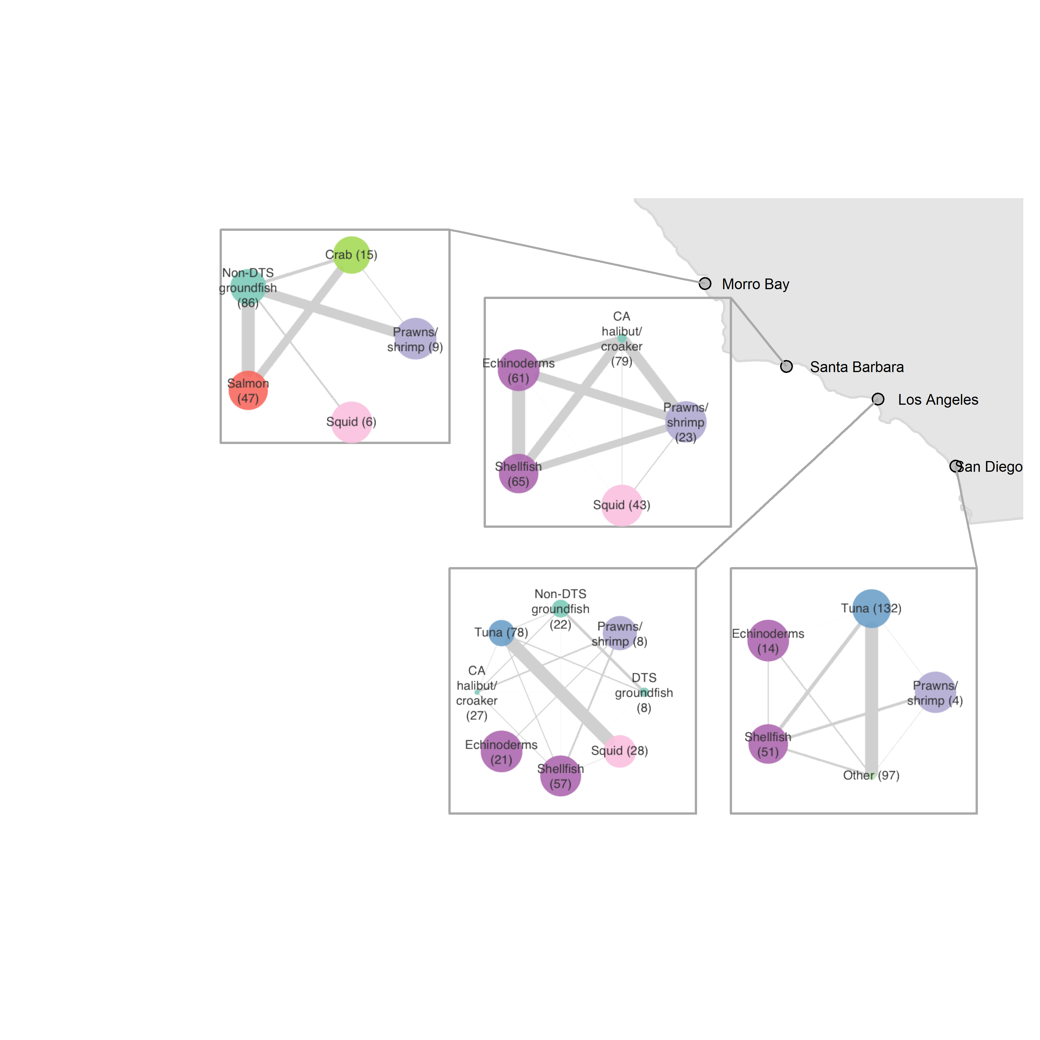
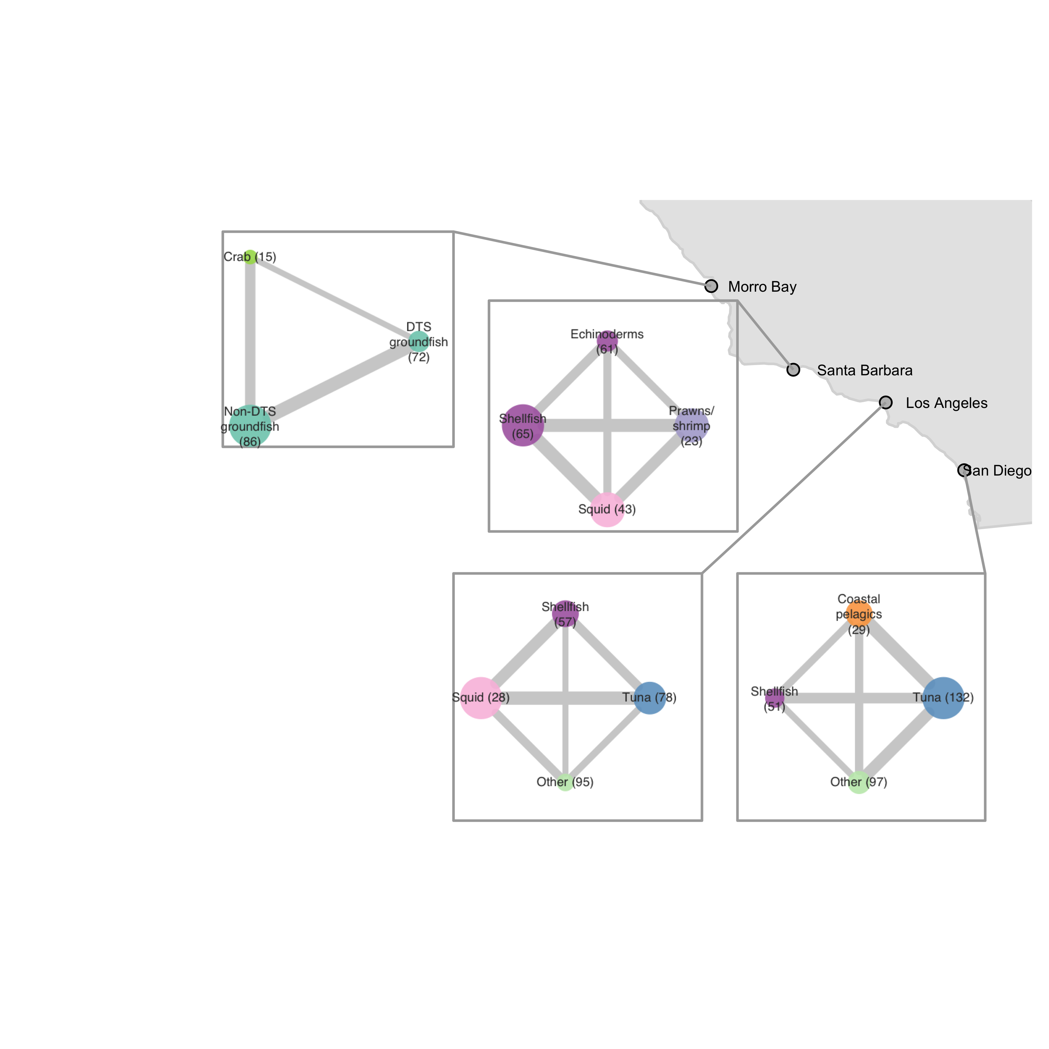
Vessel-level
includes fisheries that represent a median of 10% of vessel revenue in each port
Port-level
includes fisheries that represent at least 10% of total revenue in each port

Slide 10
Additional analyses
Comparisons of networks over time
Animations [challenge of nodes moving]
Network metric time series and/or correlations with other ESR indicators
Other definitions of communities/ports
Species groupings
Metiers?
FMP- or target species- specific networks?
Other?
Networks based on landings rather than $
Make networks that integrate over >1 year

Slide 11
5% cutoff for port-level

Slide 12
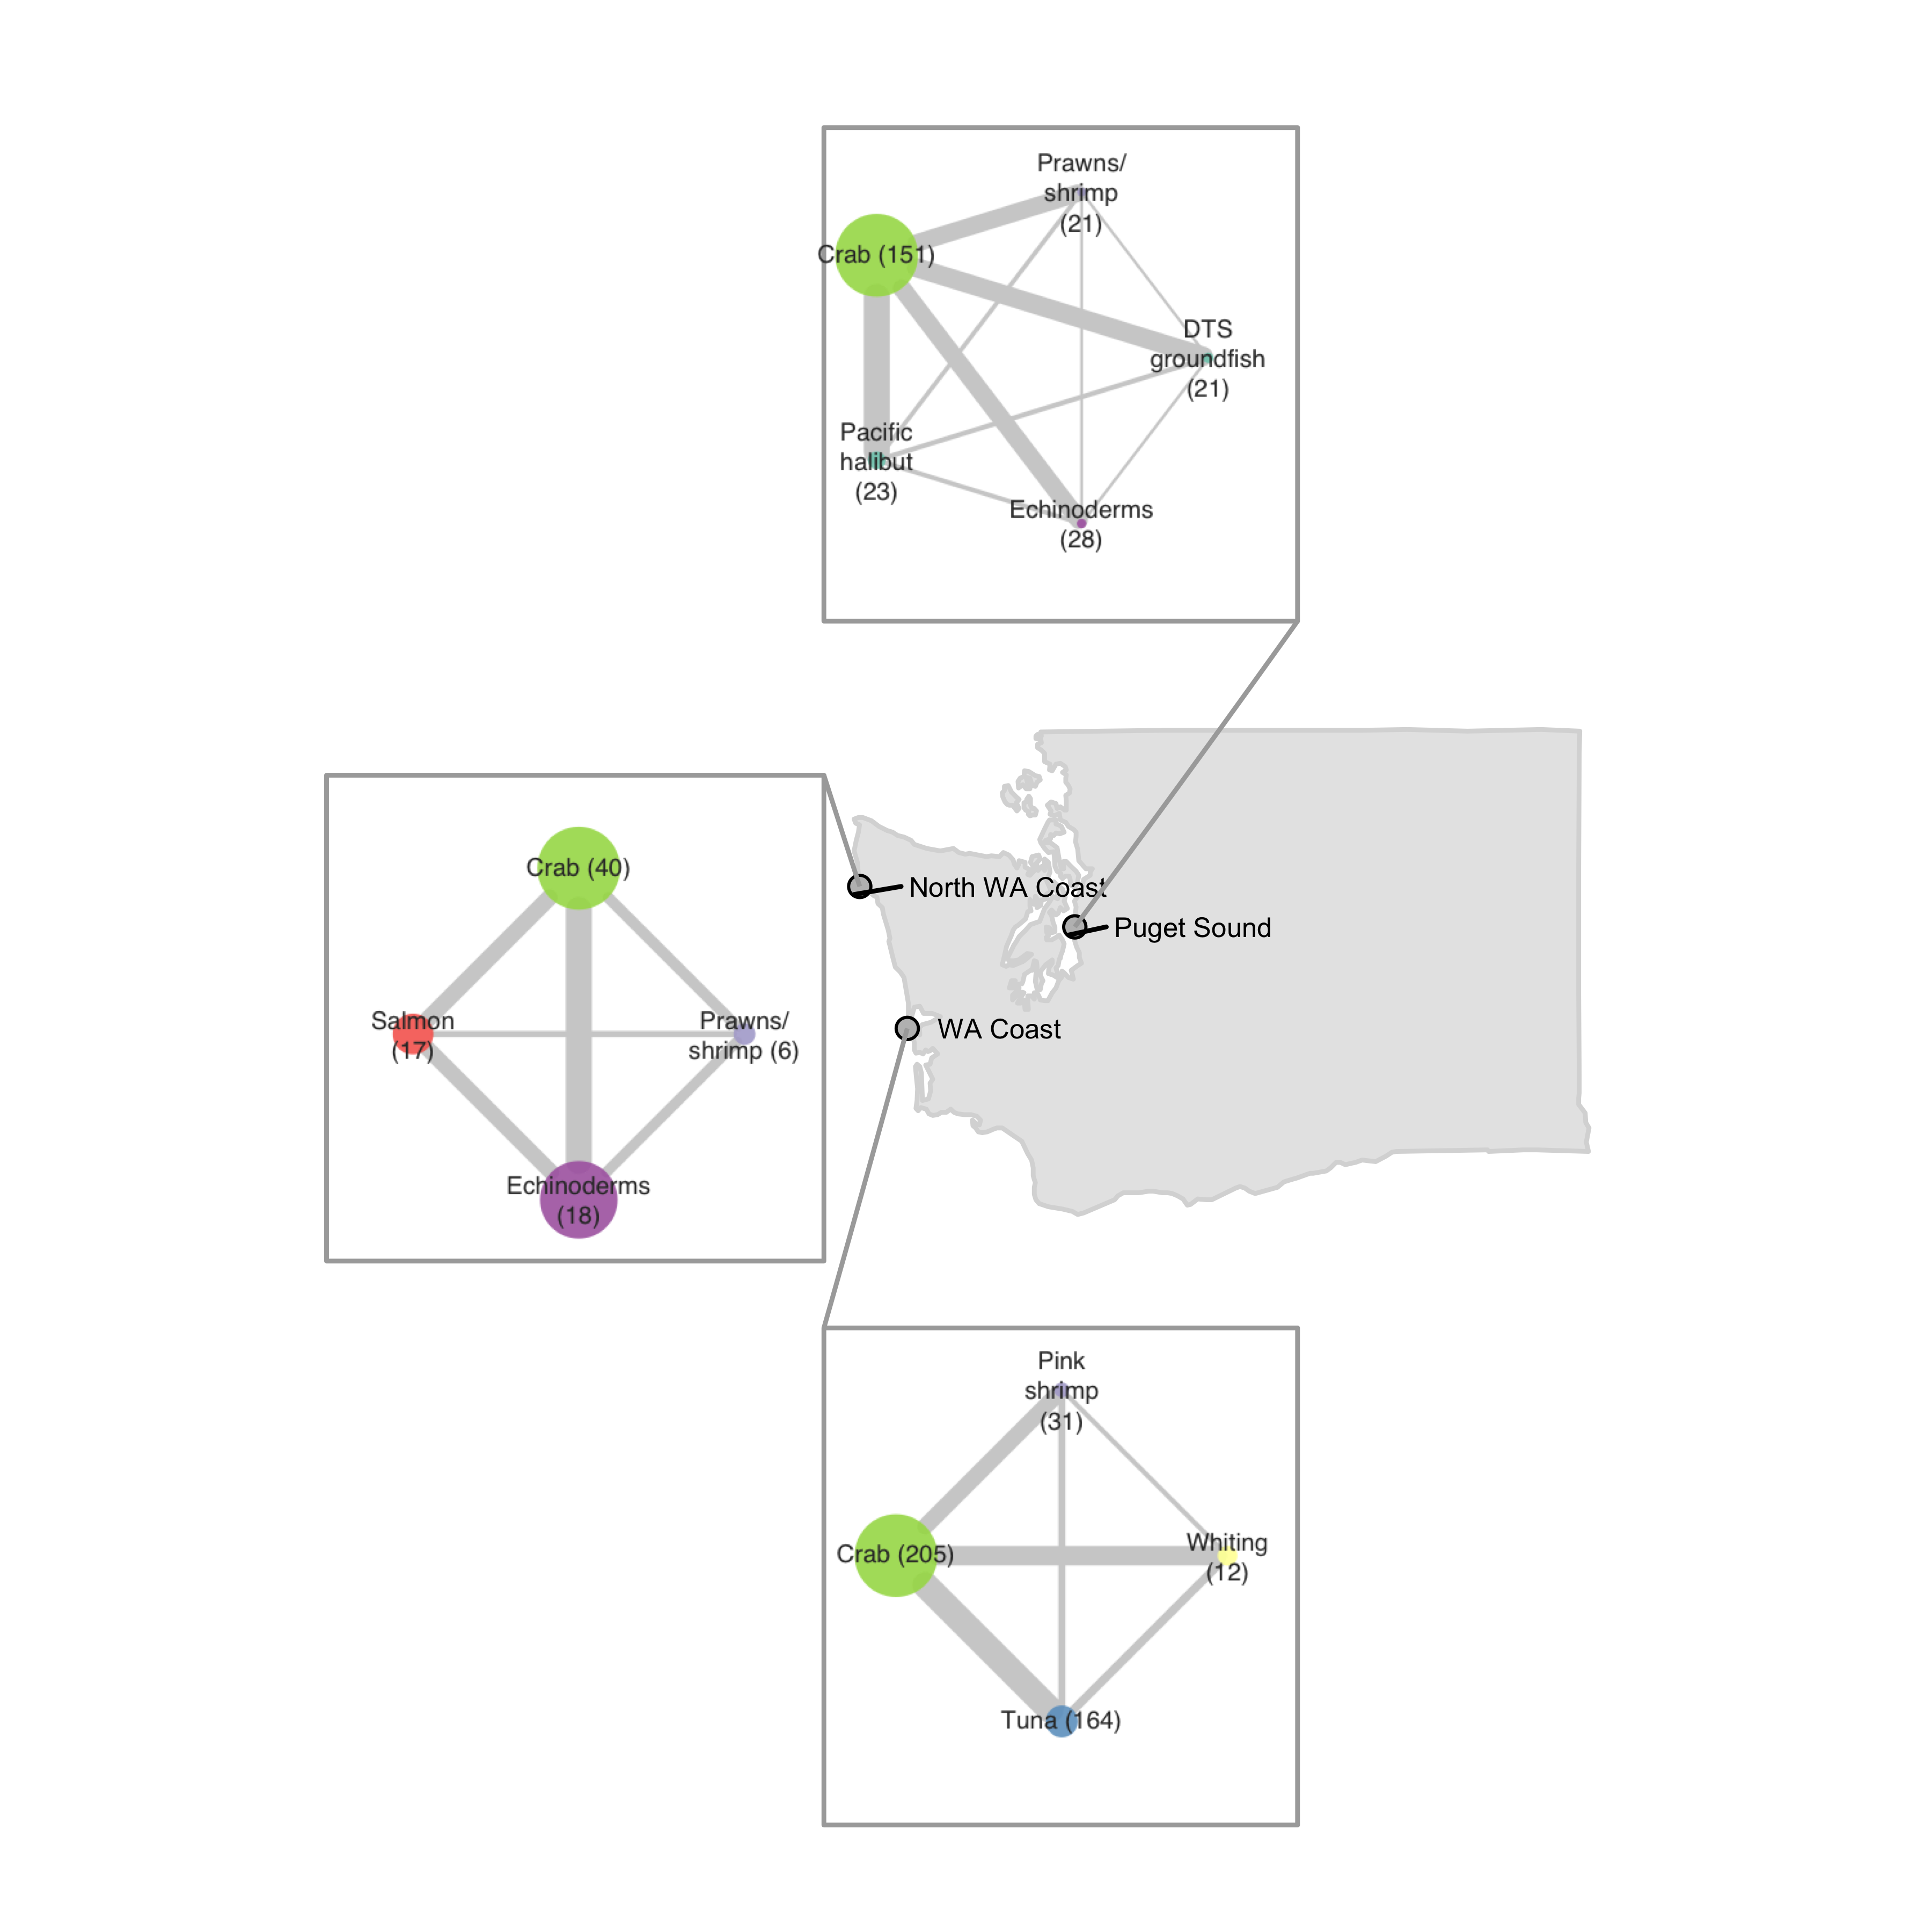
Vessel-level
includes fisheries that represent a median of 10% of vessel revenue in each port
Port-level
includes fisheries that represent at least 5% of total revenue in each port

Slide 13
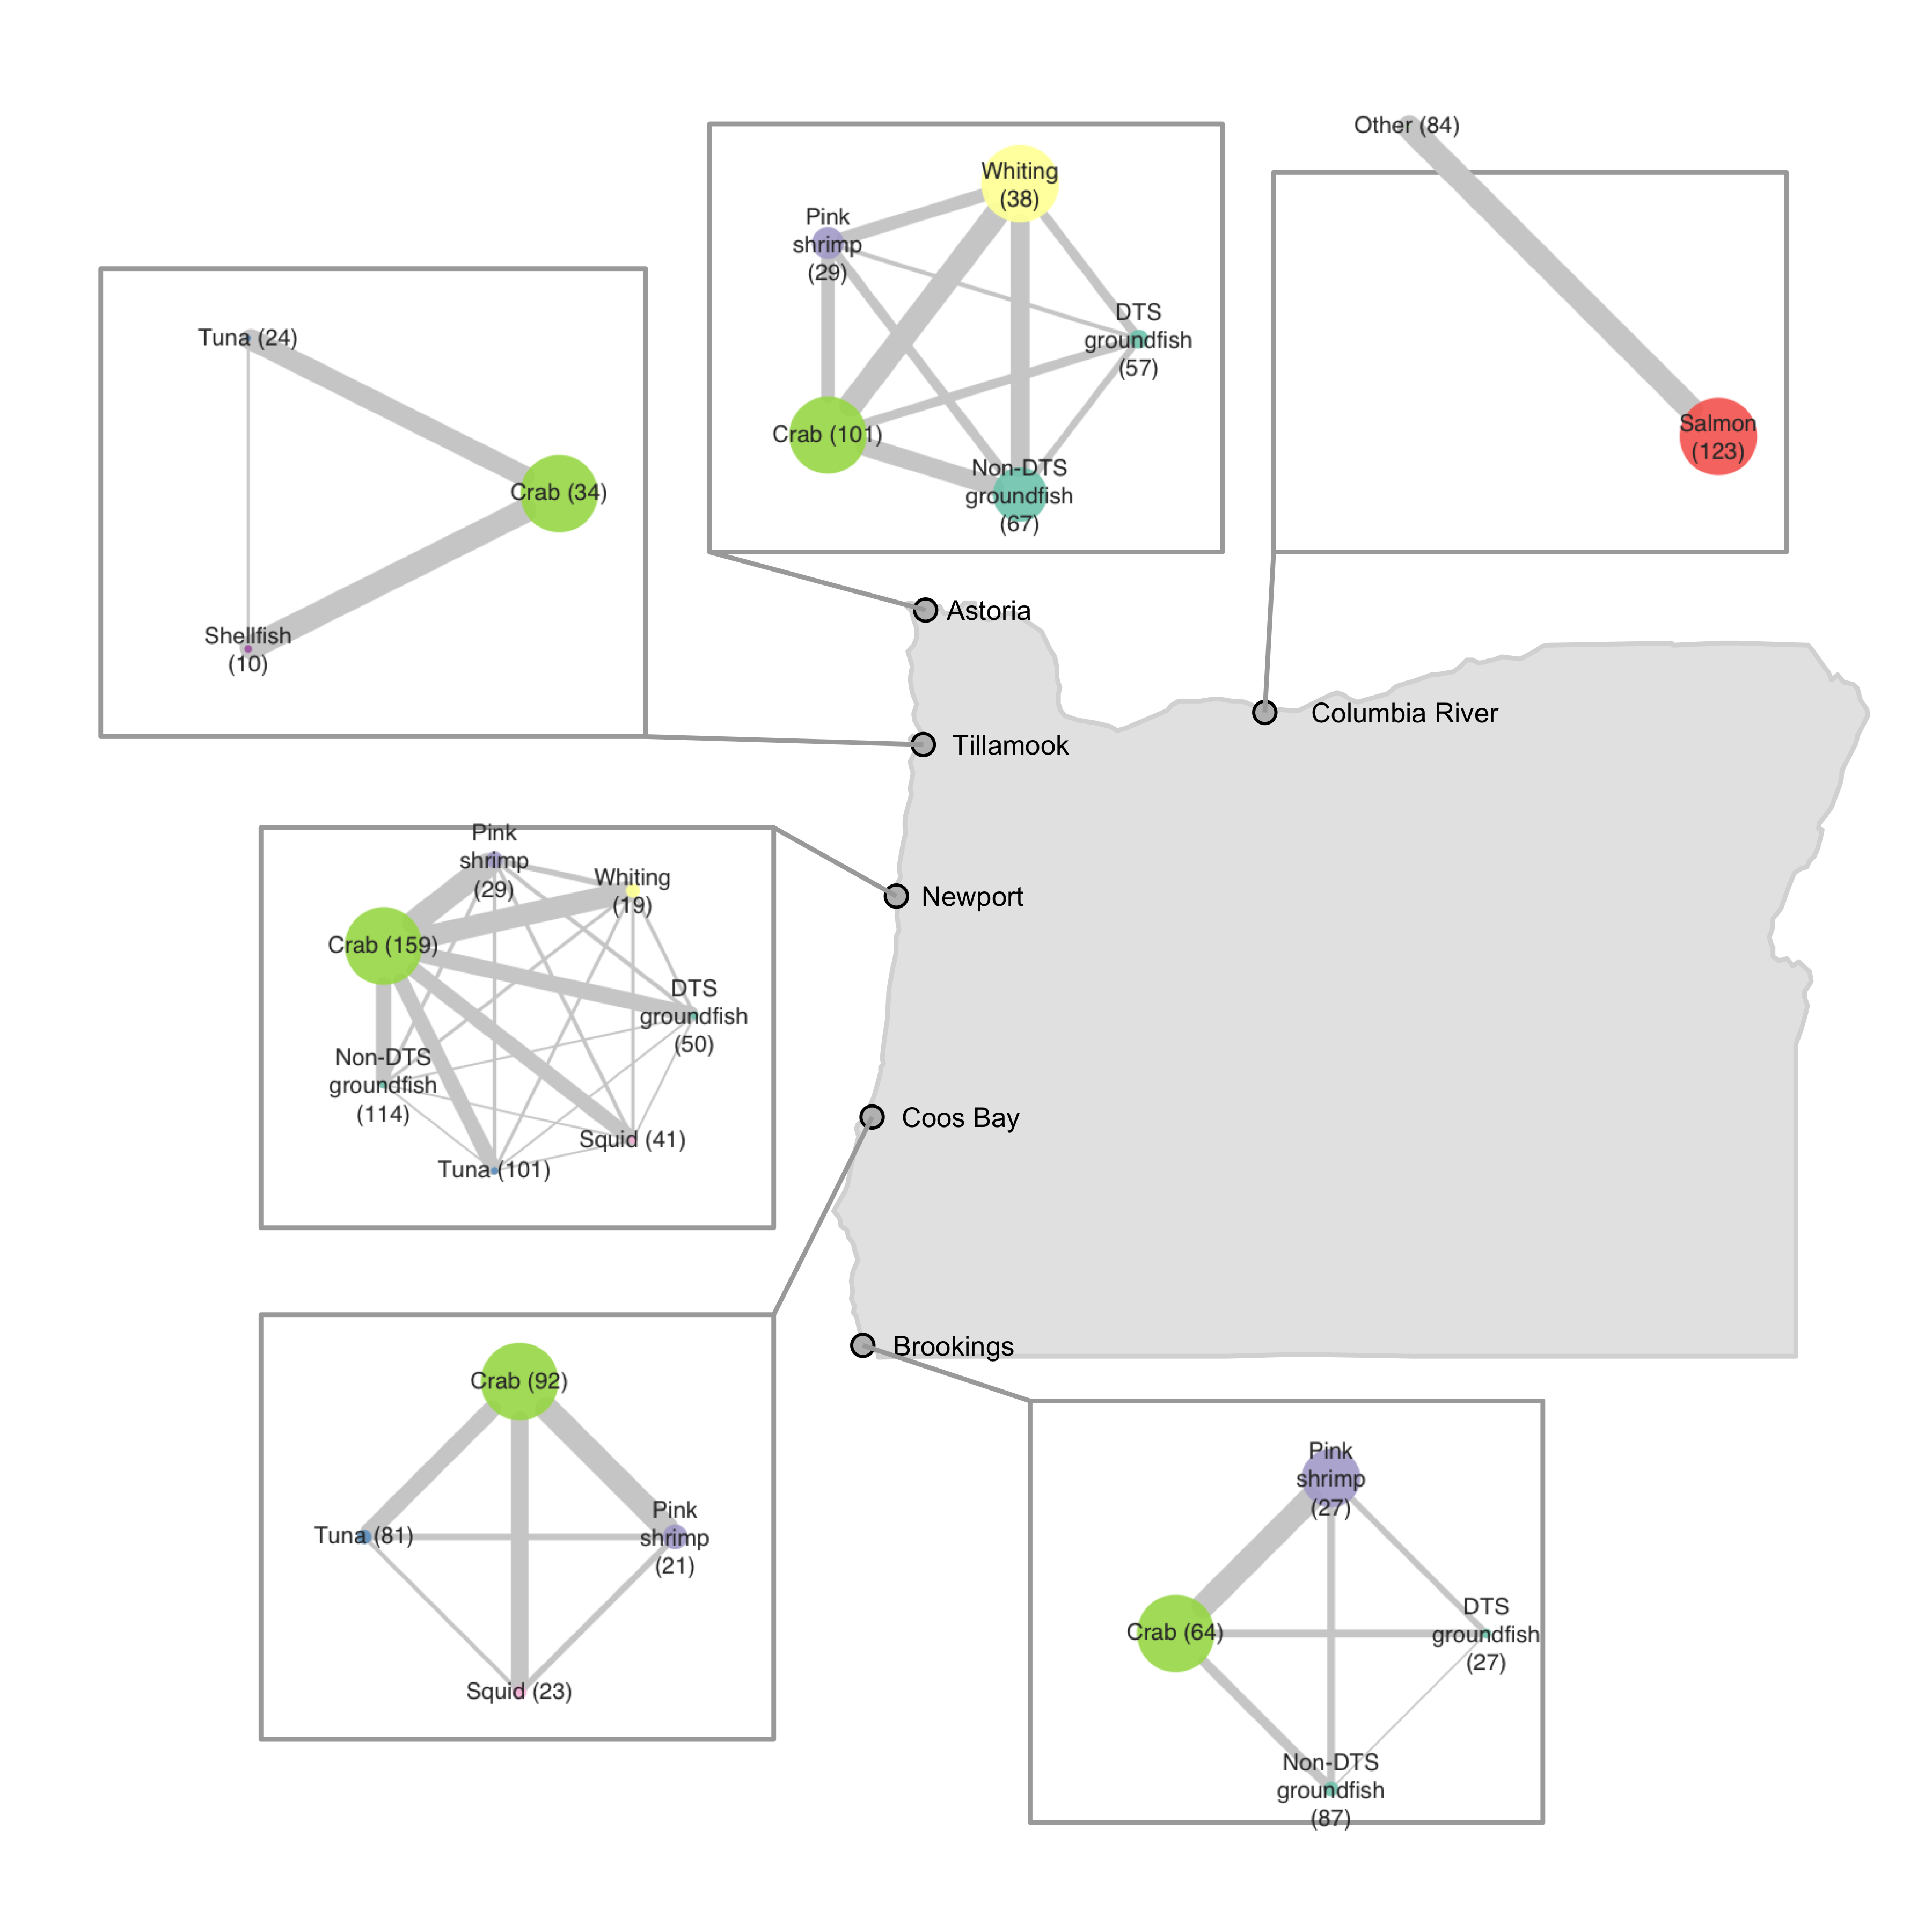
Vessel-level
includes fisheries that represent a median of 10% of vessel revenue in each port
Port-level
includes fisheries that represent at least 5% of total revenue in each port

Slide 14
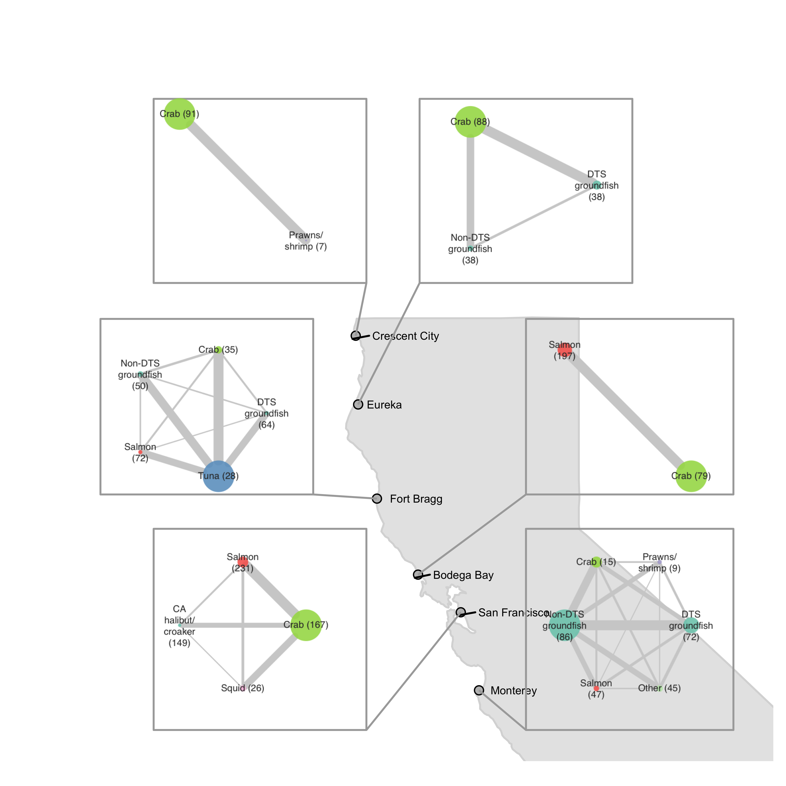
Vessel-level
includes fisheries that represent a median of 10% of vessel revenue in each port
Port-level
includes fisheries that represent at least 5% of total revenue in each port

Slide 15
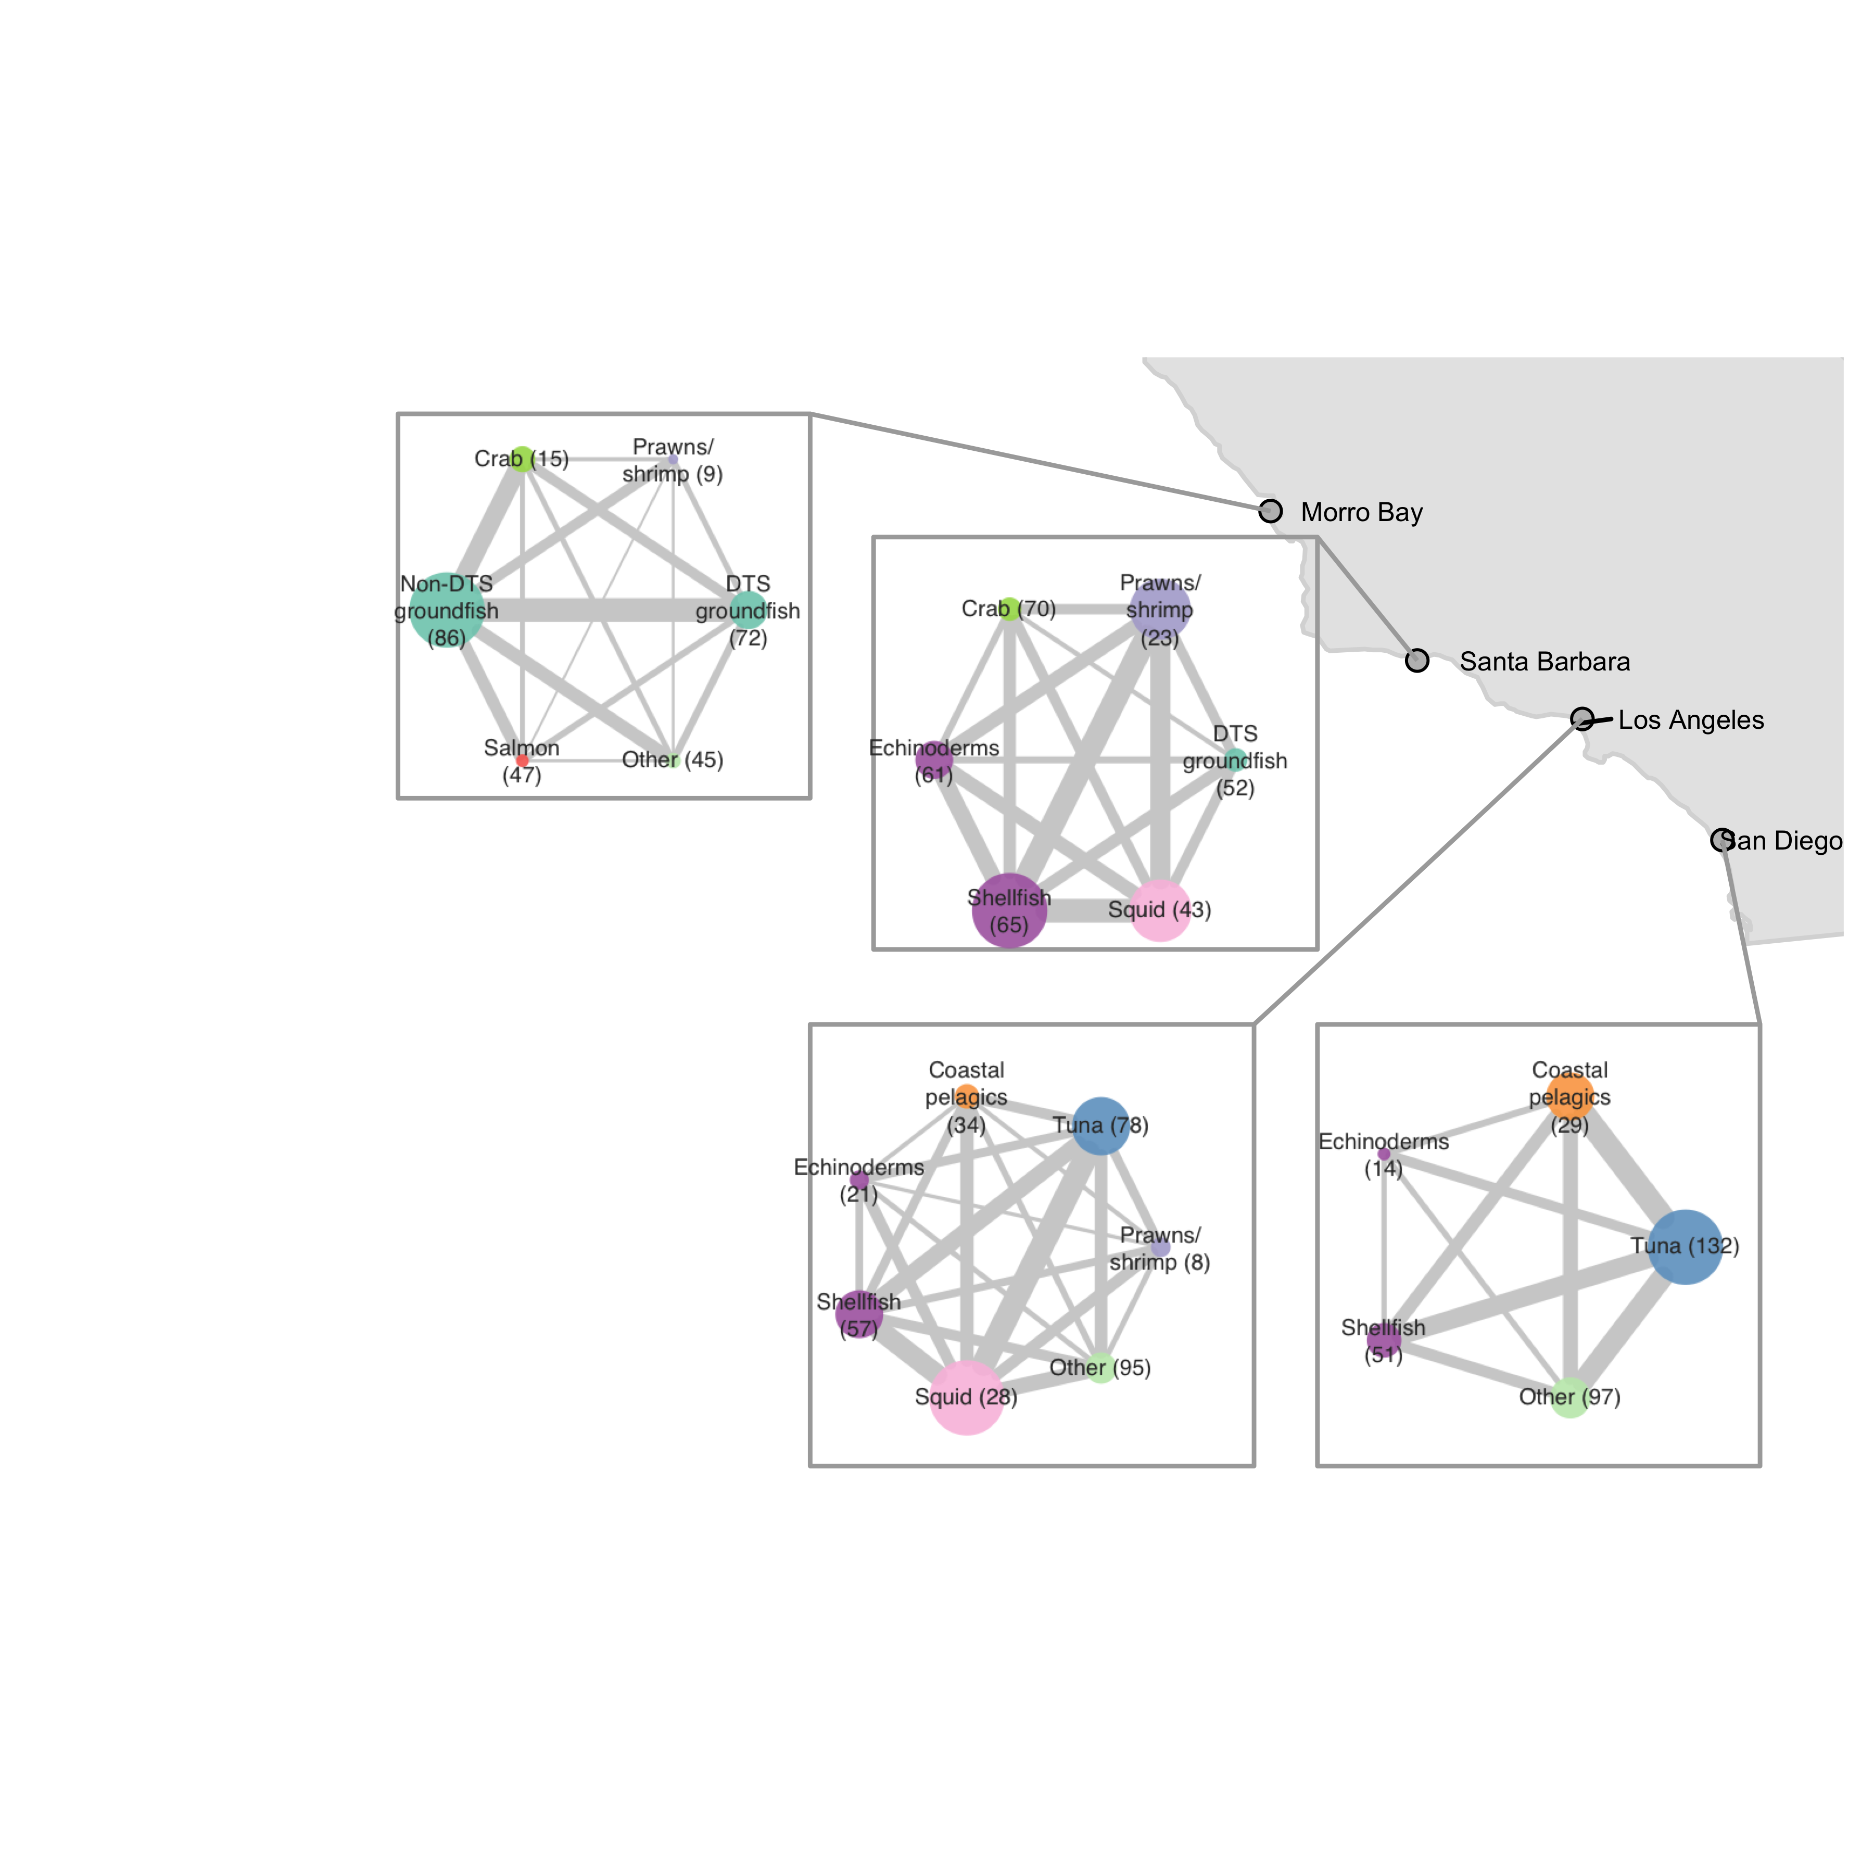
Vessel-level
includes fisheries that represent a median of 10% of vessel revenue in each port
Port-level
includes fisheries that represent at least 5% of total revenue in each port

